Slide 1
Natural gas pipeline information

Slide 2
About this course
TKO Gas pipeline response course is designed to provide awareness for emergency responders who may respond to an incident involving a TKO Gas natural gas pipeline release.
Note: This is a general guide, and any further questions can be directed to local staff
Notes:
Federal pipeline safety regulations (49 CFR 192.616 and 49 CFR 195.440) require pipeline operators to develop and implement public awareness programs that follow the guidance provided by the American Petroleum Institute (API) Recommended Practice (RP) 1162, "Public Awareness Programs for Pipeline Operators" (incorporated by reference in federal regulations).
API RP 1162 is an industry consensus standard that provides guidance and recommendations to pipeline operators for the development and implementation of enhanced public awareness programs. It addresses various elements of such programs, including the intended audiences, the kinds of information to be communicated, frequencies and methodologies for communicating the information, and evaluation of the programs for effectiveness

Slide 3
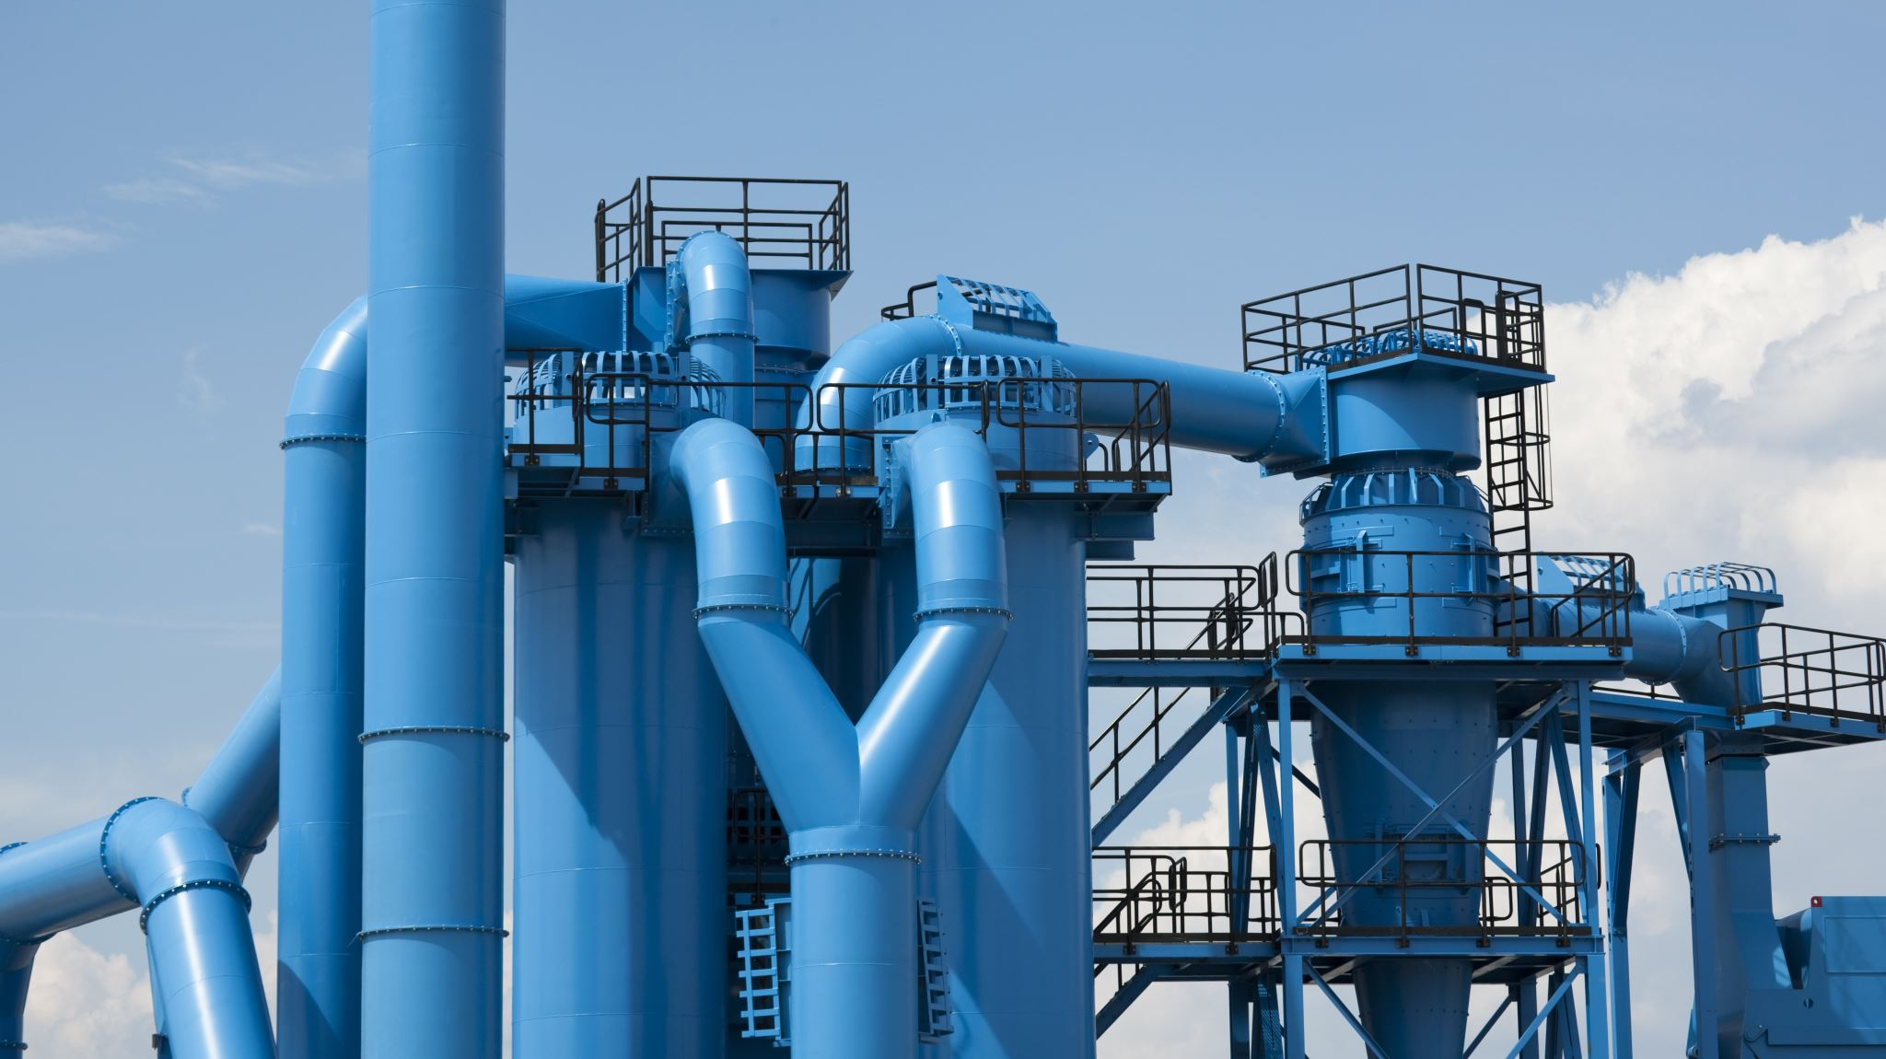
Pipeline purpose and reliability

Slide 4
Role of pipelines in U.S. energy supply
Pipelines are the safest and most efficient method to transport the energy that we need and use every day.
Our pipelines and pipeline facilities are built using industry best practices, which include using the highest quality materials during construction and implementing a rigorous pipeline maintenance program. This includes the facilities required to safely operate the pipeline, like meter stations and compressor stations.

Slide 5
Energy transportation pipeline safety record
We aim for our pipelines and facilities to operate incident-free and to ensure our assets serve our people and communities across the continent for years to come.
Pipelines are the safest, most environmentally friendly way to transport natural gas and petroleum- period. Our pipeline safety programs are among the most robust in the industry and are the most important part of our business. From pipeline integrity innovations to investing in leak detection technology and public awareness programs, safety is the common link behind everything we do.

Slide 6
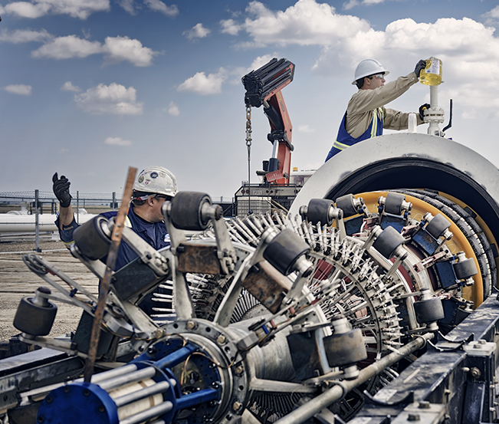
Types of TKO Gas pipelines
TKO Gas is a company based in Dalhart, Texas - in the heart of the Texas Panhandle. We provide gas service to Texas, Kansas, & Oklahoma. TKO Gas has been in operation for 10 years and have over 100 years of combined experience.

Slide 7
Federal & State regulatory agencies
The Pipeline and Hazardous Materials Safety Administration (PHMSA) regulates interstate pipelines in the United States. The following is a list of state regulatory agencies that oversees pipelines within their state.

Slide 8
Federal & State regulatory agencies
Texas Railroad Commission of Texas
https://www.rrc.texas.gov/pipeline-safety/
Oklahoma
Oklahoma Corporation Commission
https://oklahoma.gov/occ.html
Kansas
Kansas Corporation Commission
https://kcc.ks.gov/index.php

Slide 9
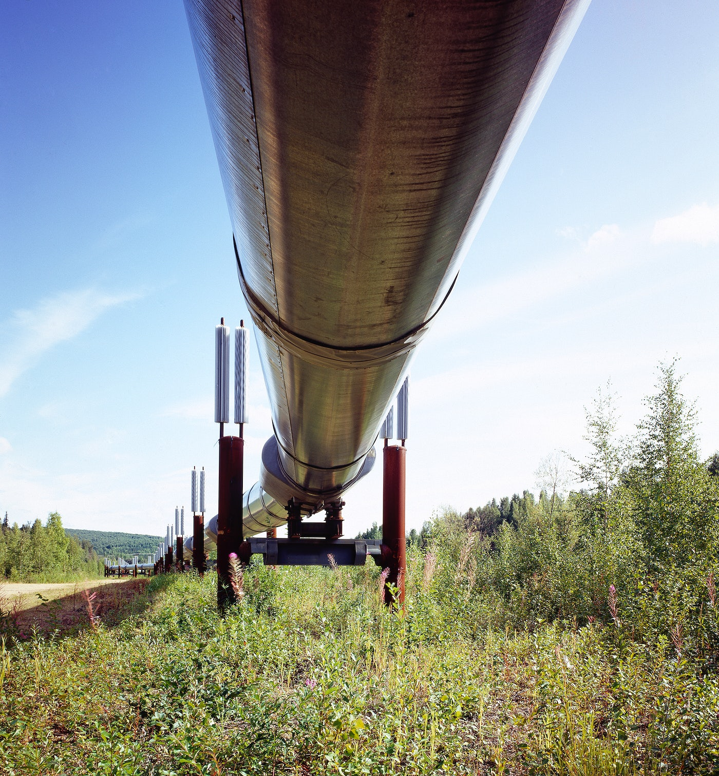
Hazard awareness and prevention measures

Slide 10
Overview of potential hazards of a gas release
Natural gas is extremely flammable and may explode if heated, natural gas may also displace oxygen and cause rapid suffocation.

Slide 11
Causes of pipeline failures
Although pipeline incidents are relatively rare, accidents do occur.
The leading cause of pipeline accidents happen because third-party excavators do not call 811 for the proper locations of the pipe before they start digging.
Even minor excavation activities can cause damage to a pipeline, it’s protective coating or to other buried utility lines.
Corrosion, material defects, worker error and events of nature can also be causes of pipeline failures.

Slide 12
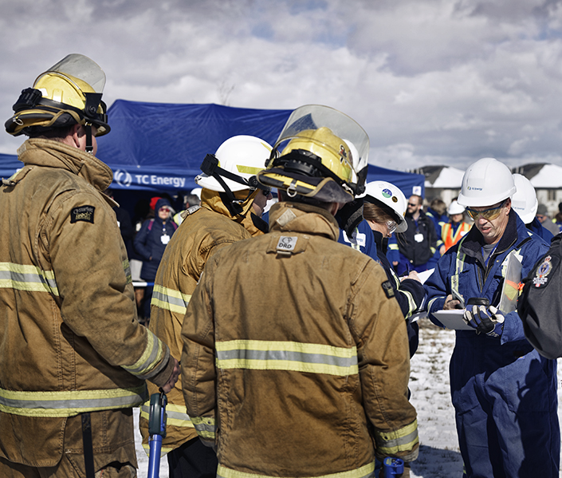
Types of TC Energy Pipelines
We build and operate safe and reliable energy infrastructure.
Product release characteristics
Natural gas is an energy source composed mostly of methane.
Natural gas is said to be odorless, but some people detect a slight hydrocarbon smell. If the gas has been odorized, it could smell skunk-like or similar to rotten eggs. Natural gas is highly flammable and explosive.

Slide 13
Potential hazards from an accidental gas release
Dizziness or suffocation if a leak occurs in a confined space or high concentration.
Ignition/fire if a spark or other ignition source is present.
Potential explosion if the natural gas is mixed with air.
Projectiles from site of leak or rupture propelled by the force of escaping gas.
In the event of a natural gas pipeline release, the environment may be impacted and could result in injuries or fatalities as well as damage property.

Slide 14
This includes but is not limited to:
Preventive maintenance program.
Ground surveys.
Cathodic protection to inhibit corrosion.
Hydro inspections to ensure the integrity of pipelines.
Prevention measures undertaken
TKO Gas invests significant time and capital in the following preventive measures and procedures:
Notes:
In addition to this, TC Energy invests millions every year in research and development to improve and enhance the safety of our pipelines, from smart drone patrolling, fiber optic monitoring, greenhouse gas reduction and environmental sustainability. TC Energy’s employees are trained to meet all mandated federal requirements for Pipeline Operator Qualifications in the U.S.

Slide 15
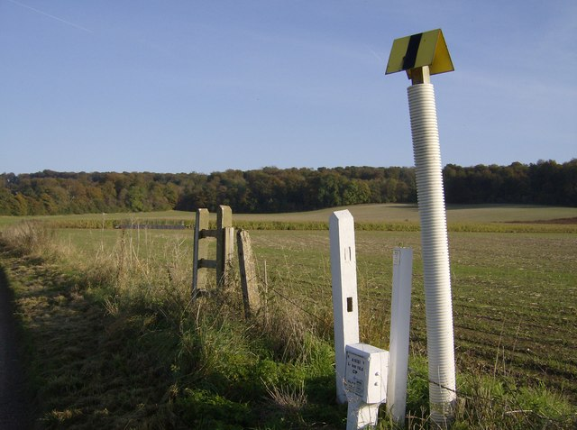
Leak recognition and response

Slide 16
Recognizing a gas pipeline leak
Although a pipeline leak is rare, it is important to know how to recognize the signs. Use your senses of sight, smell and hearing to detect a potential pipeline leak.
You might see:
You might smell:
You might hear:
Dead or dying vegetation on/near the right-of-way in an area that is usually green.
Bubbles in a body of water.
Dirt being blown into the air.
Ground frosting in summer.
Possible fire or flames above the ground, if the leak has been ignited.
Natural gas transmission lines are not usually odorized, though smaller gas distribution lines often have an additive to give it a sulphur or “rotten egg” smell.
A roaring, hissing or whistling noise.

Slide 17
TKO Gas response to a pipeline incident
In the unlikely event an incident should occur, TKO Gas will immediately dispatch trained personnel upon notification of an emergency.
TKO Gas will immediately respond by:
Shutting down the affected pipeline if necessary.
Isolating the impacted section of the pipeline through either automatic valve shutoff or manual valve operation.
Dispatching emergency personnel to the location of the incident.

Slide 18
Emergency Responders response to a pipeline incident
Secure the area around the leak
Evacuate the public
Contact TKO Gas as soon as possible at 1-806-244-4210
Establish a command center
Control Ignition Sources
Notes:
Trained crews that are dispatched to the site will coordinate a response with local emergency services. TC Energy will not restart the pipeline until the issue has been addressed and it is safe to do so, with the approval of industry regulators. TC Energy’s policies and practices for emergency response planning go above and beyond the standard regulatory requirements for emergency response.

Slide 19
TKO Gas liaison with Emergency Officials

Slide 20
TKO Gas shall establish and maintain a liaison with appropriate fire, police and other public officials to:
Learn the responsibility and resources of each government organization that may respond to a facility emergency.
Acquaint officials with the Company’s ability to respond to a facility emergency.
Identify the types of facility emergencies in which they may be notified.
Plan how the Company and Emergency Officials can engage in mutual assistance that will minimize hazards to life and/or property.
Notes:
This contact is generally established through the public awareness meetings schedules under the Public Awareness Program but shall be augmented with consultation during ERP development and invitation of Emergency Services to field exercises.

Slide 21
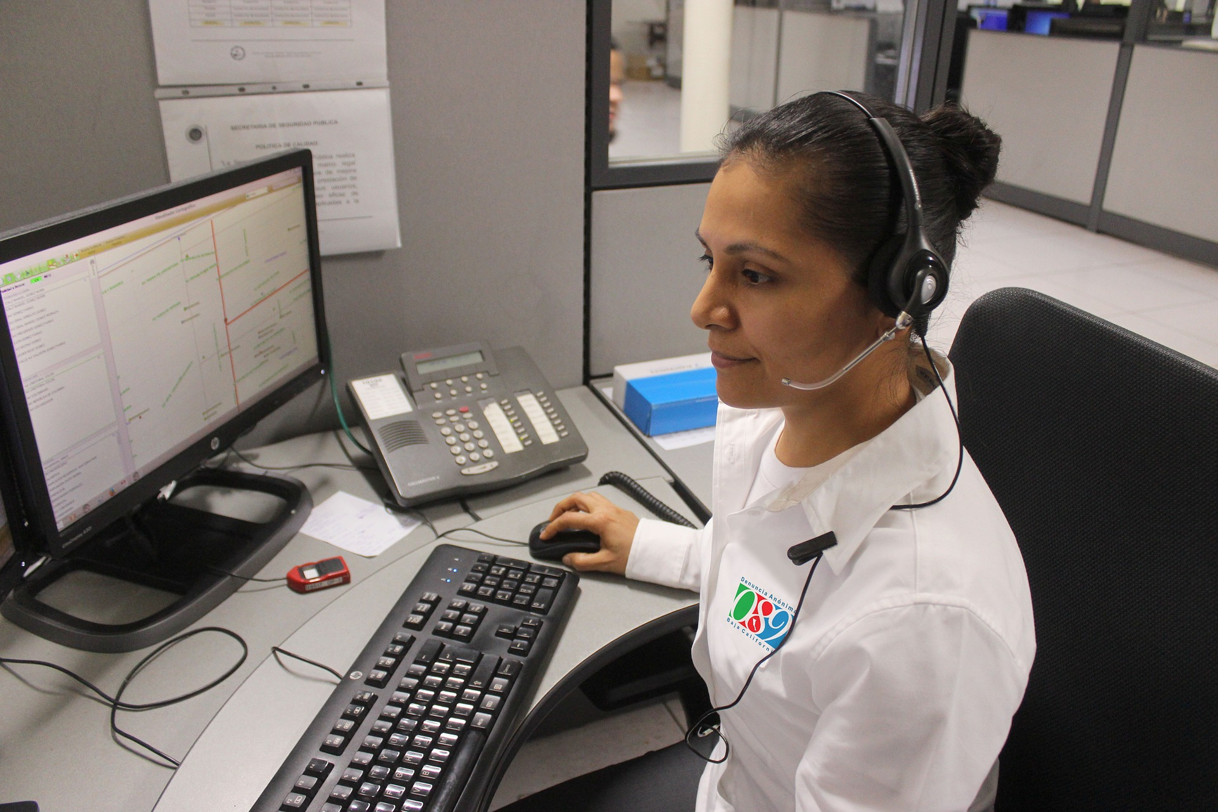
Emergency preparedness communications

Slide 22
Emergency Response Plans
TKO Gas Emergency Response Plans
Contact TKO Gas at 1-806-244-4210
PHMSA Emergency Response Guidebook (ERG): https://www.phmsa.dot.gov/hazmat/emergency-response-guidebook-erg

Slide 23
TKO Gas priority to protect life
TKO Gas makes a continuous effort to ensure the Emergency Response Plan is executed to protect life, preserve the environment, and communicate the status of an emergency to all stakeholders.

Slide 24
Emergency contacts
To report an emergency, call 911 and immediately notify TKO Gas at 1-806-244-4210
Notes:
Further information regarding pipelines located in your community can be accessed through the National Pipeline Mapping System at www.npms.phmsa.dot.gov

Slide 25
Call 811 Before You Dig! It’s SAFE. It’s FREE. It’s the LAW!
State law requires you to notify 811 BEFORE YOU DIG. This is a FREE service.
For general 811 information, visit: www.call811.com

Slide 26
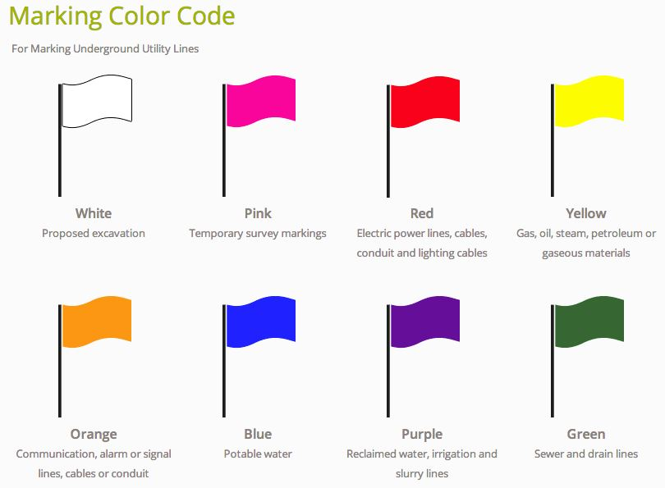
Follow these five steps to stay safe
Call 811 Before You Dig
Wait two business days
Watch for the mark
Dig with care!
Report damage immediately

Slide 27
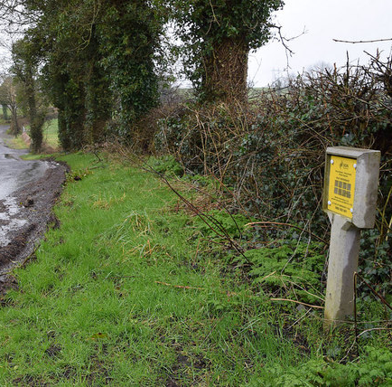
Pipeline location information
The general location of pipelines can be determined by two characteristics:
a pipeline right-of-way (ROW)
pipeline markers

Slide 28
Right-of-way (ROW)
A ROW can usually be recognized as a clear strip of land in a linear or fairly straight line, cleared of structures and trees.
The ROW contains the pipeline and a buffer area that usually extends 25 feet or more on either side of the pipeline where certain activities are restricted to ensure the continued safety and integrity of the pipeline.
The ROW must be kept clear of fences, buildings, trees or any other type of structure. The impact of a fence post, weight of a shed or the roots of a tree can cause either immediate or long-term damage to the pipeline.
These could also impede access to the area for any required maintenance or emergency situations, resulting in safety risks and possible costly impacts to structures on the ROW.

Slide 29
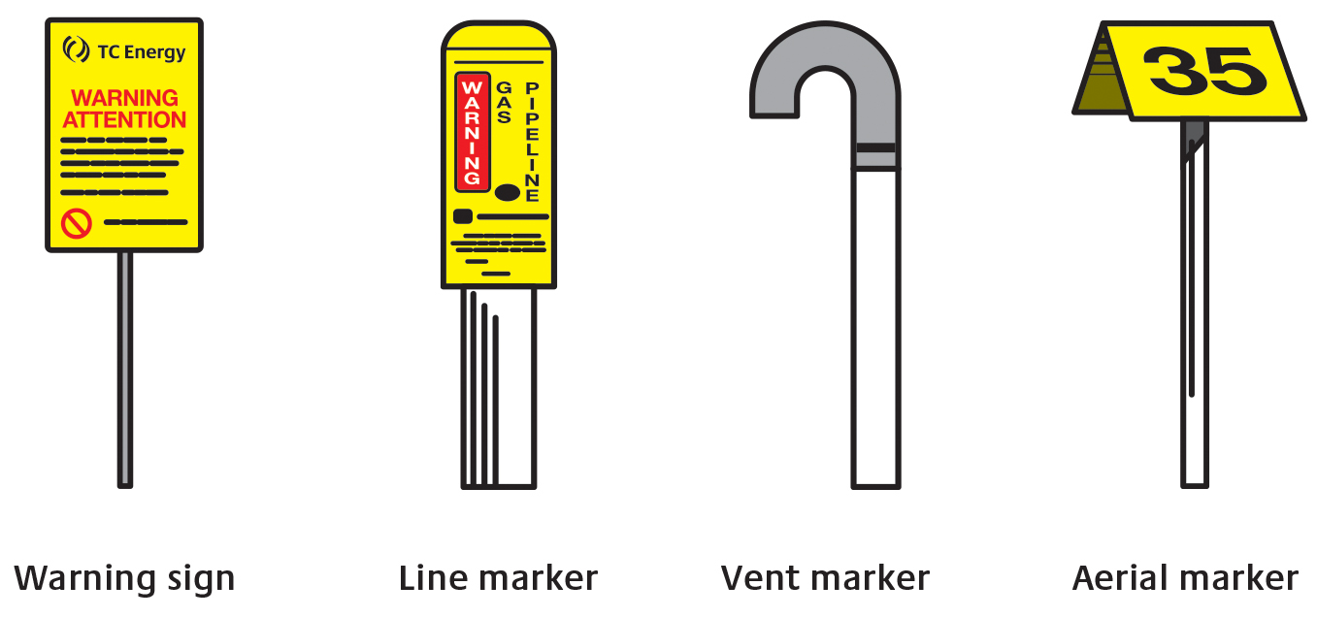
Pipeline markers
Found within line-of-sight on a ROW and at locations where the pipeline crosses streets, highways, waterways and railways.
Markers only show the approximate location of the pipeline, and the depth of the line may vary. You cannot use pipeline markers as a determination of where or where not to dig.
Pipeline markers display the pipeline operator, emergency number and the product transported in the pipeline.
It is against the law to willfully deface, damage, remove or destroy and pipeline sign.

Slide 30
National Pipeline Mapping System
Allows public access to view pipeline maps.
Search for pipeline operator contact information in a selected county, state or zip code.
Transmission lines only.
www.npms.phmsa.dot.gov
Notes:
Having awareness of pipelines located in your district is crucial. For information on transmission pipelines you can visit the National Pipeline Mapping System website. The site is useful for pre-planning in your community.

Slide 31
Additional information on company website
For additional information about TKO Gas pipelines and to connect with your TKO Gas representative, please visit:
http://www.tkogas.com/
Notes:
Federal pipeline safety regulations (49 CFR 192.616 and 49 CFR 195.440) require pipeline operators to develop and implement public awareness programs that follow the guidance provided by the American Petroleum Institute (API) Recommended Practice (RP) 1162, "Public Awareness Programs for Pipeline Operators" (incorporated by reference in federal regulations).
API RP 1162 is an industry consensus standard that provides guidance and recommendations to pipeline operators for the development and implementation of enhanced public awareness programs. It addresses various elements of such programs, including the intended audiences, the kinds of information to be communicated, frequencies and methodologies for communicating the information, and evaluation of the programs for effectiveness

Slide 32
Questions?

